Slide 1
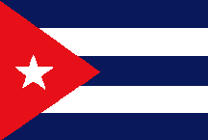
CariCOF Drought Outlook by the end of October 2014
Coordination – CIMH – Dr. Cédric J. Van Meerbeeck
Participating territories
Antigua & Barbuda, Aruba, Bahamas, Barbados, Belize, Cayman Islands, Cuba, Curaçao, Dominica, Dominican Republic, French Guiana, Grenada, Guadeloupe, Guyana, Jamaica, Martinique, Puerto Rico, St. Barth’s, St. Lucia, St. Maarten/St. Martin, St. Vincent & the Grenadines, Suriname, Trinidad & Tobago and the US Virgin Islands

Slide 2
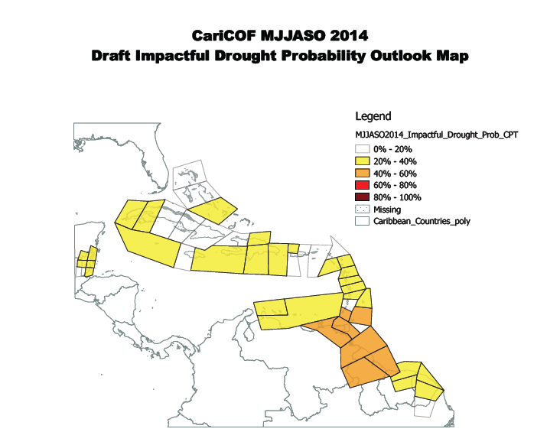
SPI outlook MJJASO – 1. what’s the probability for impactful drought?
Impactful drought is unlikely some portions of the Greater Antilles and the Bahamas, but increasingly likely further south, esp. the southern Antilles and northern Guyana.

Slide 3
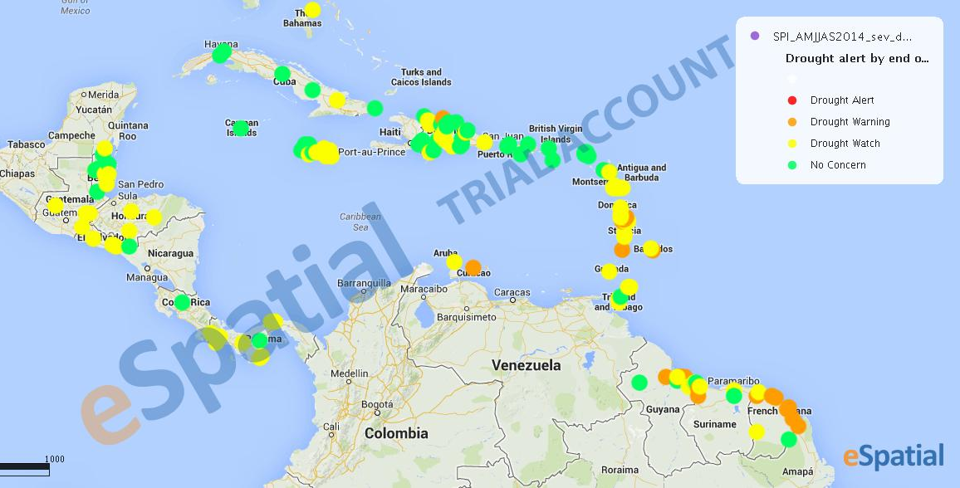
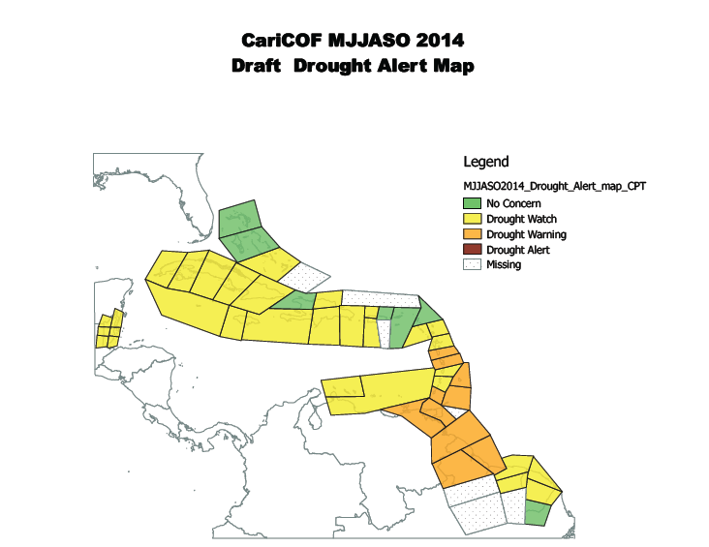
SPI outlook AMJJAS – 2. any area with imminent drought risk?
Previous month’s update: drought imminent over Martinique, St. Vincent, Barbados, Curaçao, parts of Guianas (left inset).
This month’s update: drought imminent over Dominica, Martinique, St. Vincent, Barbados, Trinidad & Tobago, northern Guyana (below).
Drought imminent in parts of Southern Caribbean

Slide 4
SPI outlook MAMJJA – 3. any shorter- or longer-term concern?
Shorter-term:
Southern Antigua, Jamaica, St. Lucia, Trinidad and Tobago have suffered water shortages.
The drought situation is expected to improve over Jamaica after July, but possibly deteriorate over southern portions of the Antilles.
Longer-term:
El Niño is associated with a drier wet season.
If El Niño manifests, less water will be stored during the wet season.
By consequence, less water would be available for use in the dry season, which is our tourist season.
CONSERVE WATER!! Especially in Jamaica, the Eastern and Southern Caribbean

